Slide 1
Audio-Based Bearing Fault Detection on Resource-Constrained
Microcontrollers: An Ablation-Driven
Study
Master’s Thesis Presentation
Ramin Nassiri — M.Sc. Electrical & Microsystems Engineering (MEM)
Supervisors:
Prof. Dr.-Ing. Armin Sehr (Primary)
Prof. Dr.-Ing. Johannes Reschke (Second examiner)
OTH Regensburg — SES Laboratory
10 September 2025 · 15:00 · Room S-125

Slide 2
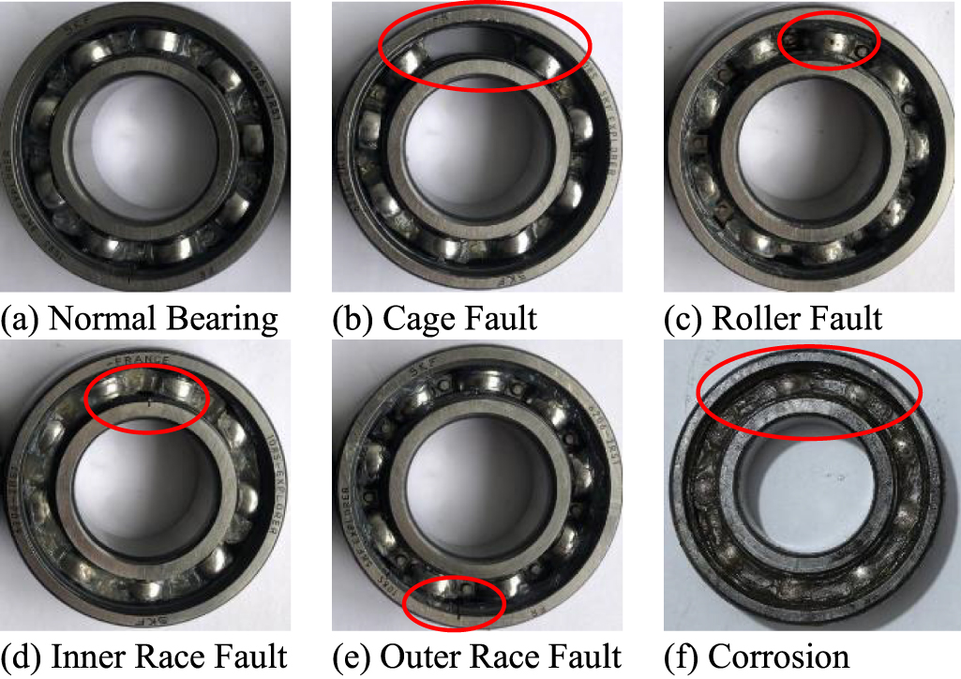
What are bearings?
Machine elements that reduce friction between rotating parts ((rot) shaft ↔ (stat)housing)

Slide 3
Why PDMS (Predictive Maintenance Systems)?
Detect faults early → avoid unplanned downtime, safety incidents, and high repair costs.
SES-Lab PDMS so far (baseline):
Strong track record with vibration-based monitoring and classification.
Proven ML pipelines on embedded targets.
Gap: on-device audio feasibility not yet established.
Motivation to add audio (complement vibration):
Certain defects radiate acoustic energy before strong vibration signatures.
Redundancy: second modality improves robustness and fault coverage.
Enables testing in scenarios where accelerometer mounting is impractical.
E.g. Hazardous/ATEX areas, Food/pharma (CIP/SIP & 3-A sanitary), High-temperature surfaces and …

Slide 4
SES-Lab PDMS: Baseline Pipeline (GMM/MLP + 25 Features)
Simple pipeline (end-to-end):
Acquire → sensor stream (vibration baseline; audio in this work)
Segment → fixed windows (e.g., 0.5–1.0 s)
Preprocess → DC removal, normalization
Filter → HPF / notch / band-pass (defect-band focus)
Feature extraction (SES-25) → 10 time(e.g. Mean, Standard deviation,...) + 13 freq(e.g. Dominant frequency, Bandwidth, ...) + 2 autocorr(e.g. Energy)
Scale → Min-Max or z-score
Inference (pre-trained model) → GMM or small MLP
Aggregate (optional) → segment → file decision (majority / mean-prob / median log-lik.)

Slide 5
GMM — Gaussian Mixture Model
Type: Can be unsupervised (clustering), but in our project we use it in a supervised way: fit one GMM to “healthy” and one to “faulty,” then compare which model likes a new sample more.
How to think of it: “Which class’s shape does this feature vector look like?”
Pros: Tiny, very fast on ESP32; great with small datasets.
Cons: Simpler boundaries; may miss tricky non-linear patterns.
MLP — Small Neural Network
Type: Supervised (needs labeled data).
How to think of it: Learns a direct rule to map features → class (healthy/faulty).
Pros: Captures non-linear combos of features; often higher F1.
Cons: Slightly larger; needs careful scaling/tuning.

Slide 6
Dataset & Preparation
Source
University of Ottawa Rolling-Element Bearing Dataset (Sehri & Dumond, 2023; Mendeley).
Sessions recorded at 42 kHz, 10 s each; controlled operating conditions.
Class balance used here: 20 healthy + 40 faulty audio tracks (10 s each → ~10 min total).
Then split the segments: All segment WAVs were randomly shuffled and divided 70 % / 15 % / 15 % into train / val / test to avoid leakage.
Why this dataset?
Clean labels & controlled setup → clear ground truth for method comparison.
Consistent sampling (42 kHz) → easy conversion/standardization.
Public & reproducible → results are benchmarkable.
Segmentation (how we used it)
Offline experiments: split each 10-s file into fixed-length windows (many segments per file) for training/inference.

Slide 7
What is an ablation study — and why do it?
Definition: Systematically change one component at a time (or in small, controlled combos) to see how each choice affects results.
Why it matters: Isolates what actually helps, avoids cargo-cult pipelines, and lets you pick a design that balances accuracy vs. deployability
How many did we run?
Total runs: 104 experiments, 82 main the rest side quest!

Slide 8
What we ablated?
*Signal & segmentation
Sampling rate: 8 kHz vs 16 kHz — lower SR = cheaper; higher SR = more detail.
Segmentation (B1/B2) — different window/hop to balance context vs. latency.
*Denoising & filtering
HPF (~100 Hz) — remove DC/very-low drift.
Notch 50 / 60 Hz — suppress mains hum.
Pre-emphasis — tilt spectrum to boost higher freqs.
Band-pass: 1–5 kHz and 1–3.5 kHz — focus on defect-rich bands, cut noise/compute.
Spectral whitening (FFT) — flatten spectrum to highlight narrowband cues.
*Envelope & dynamics
Hilbert envelope — extract amplitude envelope (impacts/tonality).
Log compression: norm90 / norm95 / norm99 — tame dynamic range; different reference levels.
*Feature representation
SES-25 (time/freq/autocorr) — the lab’s compact 25-feature set.
Log-Mel (20 / 40 bands) — perceptual band energies with summaries.
MFCC-20 means (25D) — cepstral summary akin to speech features.
MFCC-20 + deltas (45D) — adds short-term dynamics to MFCCs.

Slide 9
*Feature scaling & dimension
Scaling: Min-Max, z-score, RobustScaler — keep features comparable so models behave as trained.
PCA: k = 4 and k = 8 (and “none” in some baselines) — reduce dimension to cut overfit/compute.
*Classifier choice
GMM — tiny & fast; outputs log-likelihoods.
MLP — small NN; better non-linear boundaries.
Probes: RF and ET — sanity checks vs classical trees.
*GMM extras
Outlier trimming / refit (5–10%) — remove odd training samples before final fit.
Fixed likelihood threshold (e.g., “95% keep”) — explicit decision rule on scores.
*Aggregation (segment → file)
Majority vote — count labels; simple & robust.
Mean probability (MLP) — average confidences, then decide (e.g., ≥0.5).
Median / Sum of log-likelihoods (GMM) — robust combination of per-segment scores.
Per-file thresholds — e.g., “mean prob ≥ 0.5” or “mean score vs. threshold”.

Slide 10
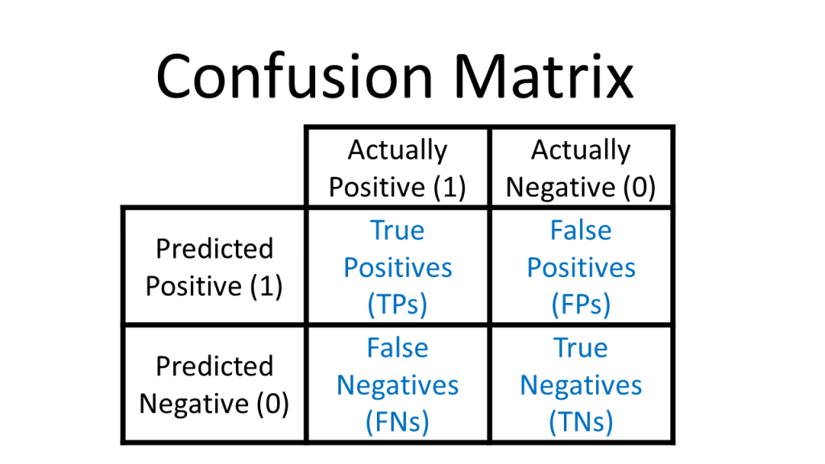
Metrics & why we pick F1
What we log for each ablation
Confusion matrix: TP / FP / FN / TN (the ground truth of errors).
Accuracy: overall hit-rate.
Precision: “When we say fault, how often are we right?”
Recall: “Of all real faults, how many did we catch?”
F1: one number that balances precision & recall.
Why F1 is our selection metric
Accuracy can mislead when classes are imbalanced.
PDMS cares about both false alarms (FP) and missed faults (FN).
F1 is the harmonic mean of precision & recall → penalizes models that are strong in only one.
Gives a single, fair scalar to rank ablations while we still inspect the confusion matrix and report accuracy for context.

Slide 11
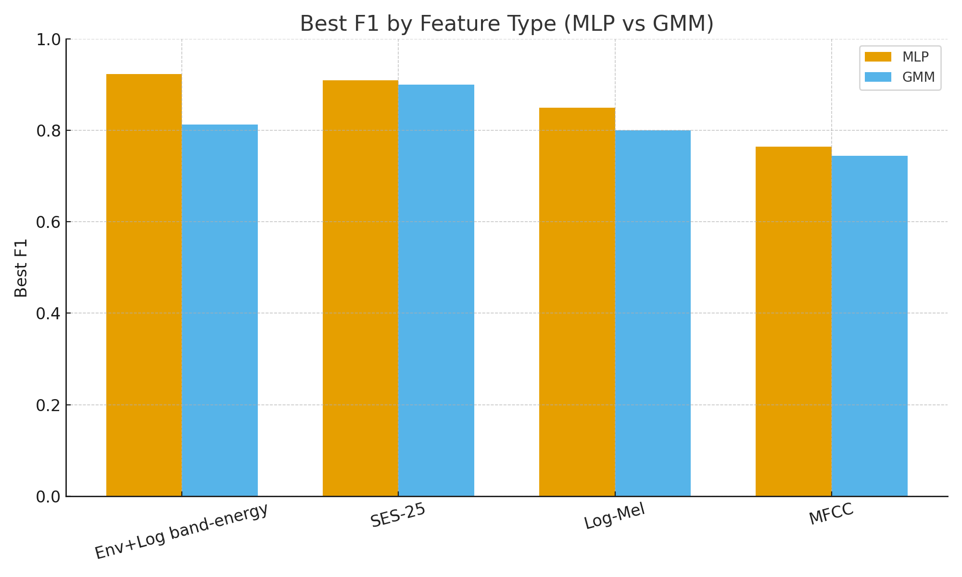
1) Feature family matters most
MLP + Env+Log band-energy reached the top F1 (0.923).
GMM + SES-25 peaked at 0.900; GMM didn’t benefit from Env+Log as much.
Takeaway
Pick features to match the model: Env+Log for MLP; SES-25 for GMM.

Slide 12
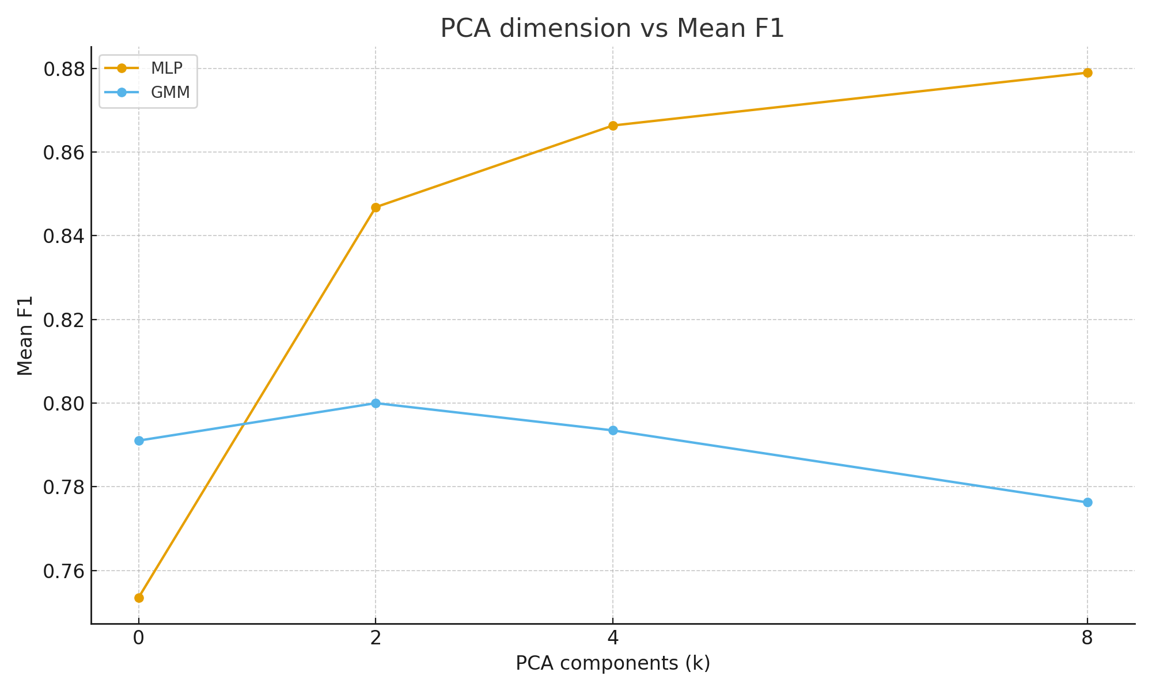
2) Right PCA size helps (especially for MLP)
What we saw
MLP: average F1 improved up to PCA = 8; PCA = 4 close behind.
GMM: small PCA (2–4) fine; 8 didn’t help on average.
Why this happens
PCA removes noise/correlation → cleaner decision boundaries for MLP.
Too much reduction can drop class cues; too little keeps noise.
GMM prefers compact, well-conditioned inputs; small k keeps covariances stable.
Takeaway
Use k ≈ 8 for MLP, k ≈ 2–4 for GMM as sensible defaults.

Slide 13
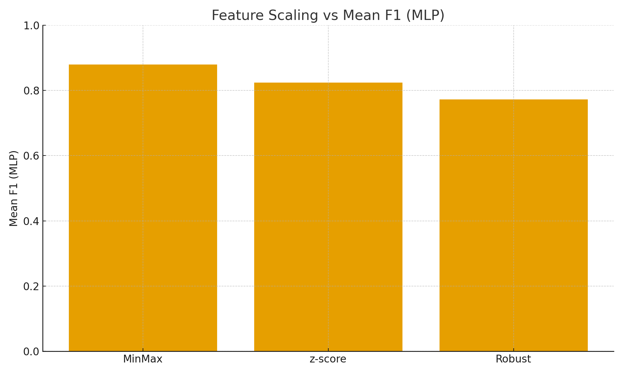
3) Scaling choice: MinMax > z-score (for MLP)
What we saw
MLP: MinMax gave the best mean F1; z-score was OK; Robust lagged.
GMM was less sensitive, but consistent scaling still mattered.
Why this happens
With small MLPs, keeping features in a bounded range helps training stability and aligns with activations/regularization.
z-score can amplify tails; Robust can under-scale informative peaks.
Takeaway
Default to MinMax for MLP; keep train/test scaling identical.

Slide 14
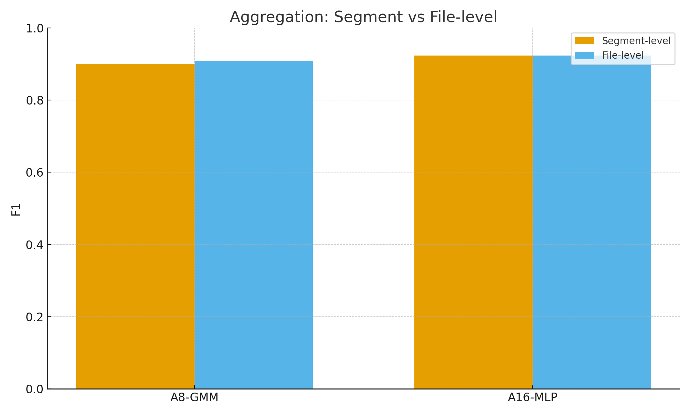
4) Aggregation boosts stability (small F1 bump for GMM)
What we saw
A8-GMM: 0.900 → 0.909 with file-level aggregation.
A16-MLP: stayed at 0.923; still reduces flip-flops in per-file decisions.
Why this happens
Segment predictions are noisy; pooling (majority/mean/median log-lik) cancels out odd segments.
GMM benefits more because its per-segment decisions are a bit weaker; MLP is already strong per segment.
Takeaway
Always aggregate for final machine/file decisions—even when F1 barely moves, stability and interpretability improve.

Slide 15
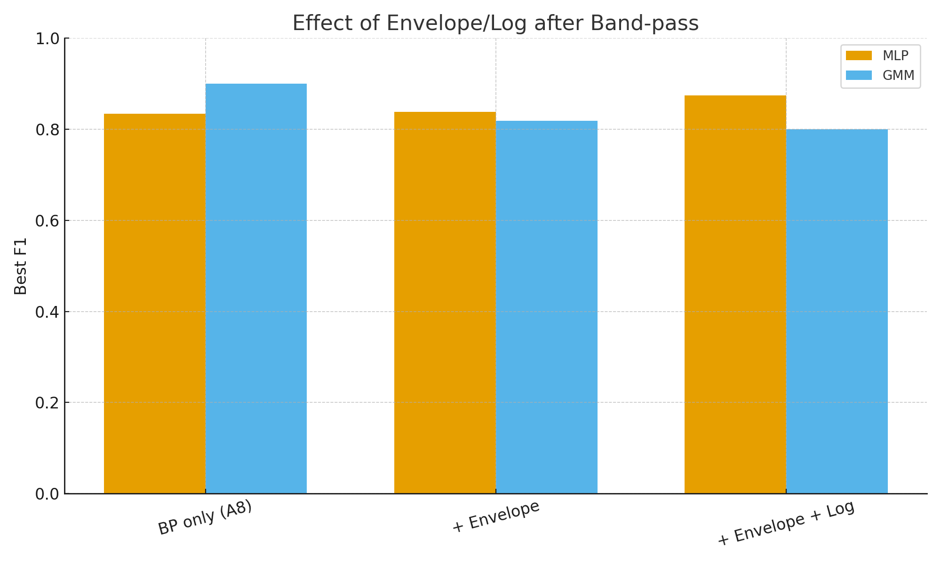
5) Envelope + log helps MLP, not GMM
What we saw
MLP (BP 1–5k): 0.833 → 0.874 after adding envelope + log.
GMM: 0.900 (BP only) dropped to 0.800 with envelope/log.
Why this happens
Envelope+log linearizes “loudness” and spotlights periodic/impact cues—MLP exploits these non-linear patterns.
GMM expects roughly Gaussian clusters; envelope/log can distort them, hurting mixture fits.
Takeaway
Use envelope+log when your classifier is MLP; prefer plain band-energy/SES-25 for GMM.

Slide 16
6)Tiny extra (no figure): in the Env+Log pipelines, 8 kHz tended to edge out 16 kHz for MLP (higher mean and best F1), while GMM gains were modest and more configuration-dependent.

Slide 17
Champion 1 — A16-MLP (Best overall F1)
Config (what it does):
SR: 8 kHz
Band: 1–3.5 kHz band-pass
Feature front-end: Envelope + Log (on the band-passed signal)
Dimensionality: PCA = 8
Scaling: MinMax
Classifier: MLP (small fully-connected net)
Aggregation (file-level): mean probability ≥ 0.5 (optional; same headline F1)
Metrics (from your runs):
Segment-level: F1 = 0.923, Acc = 0.889, Prec = 0.857, Rec = 1.000
File-level (mean-prob): F1 = 0.923, Acc = 0.889, Prec = 0.857, Rec = 1.000
Why it works:
Env+Log turns the band energy into a stable loudness trace; PCA(8)+MinMax gives clean inputs; MLP captures the non-linear cues → top F1 with perfect recall in your test split.

Slide 18
Champion 2 — A8-GMM (Simplest/fastest strong performer)
Config (what it does):
SR: (as in the run)
Band: 1–5 kHz band-pass
Feature set: SES-25 (time/freq/autocorr stats)
Classifier: GMM (class-conditional mixtures)
Aggregation (file-level): majority vote on segment labels
Metrics (from your runs):
Segment-level: F1 = 0.900, Acc = 0.877, Prec = 0.978, Rec = 0.833
File-level (majority): F1 = 0.909, Acc = 0.889, Prec = 1.000, Rec = 0.833
Why it works:
Clean band-pass + SES-25 matches GMM’s Gaussian assumptions; it’s tiny and fast, and file-level aggregation bumps stability and F1 with zero false alarms in your test split (Prec=1.0).

Slide 19
Why A8-GMM?
It uses the 25 classic features (simple band-pass + stats), is much faster and easier to implement on ESP32 than the MLP stack.
Results:
F1 ≈ 0.90–0.91, Precision ≈ 1.00, Recall ≈ 0.83 (same accuracy as offline).
Latency: ~70–75 ms per frame (FFT fast, but MicroPython PCA+GMM still ~64 ms).
Real-time?
At a 16 ms hop: No (≈70 ms/frame is too slow).
If you either increase hop to ~64–80 ms or move the tiny model to C, then yes, real-time is practical.

Slide 20
• Sehri, M., & Dumond, P. (2023). Rolling-Element Bearing Acoustic Dataset. Mendeley Data.
• Sehri, M., Dumond, P., & Bouchard, M. (2023). “University of Ottawa rolling-element bearing vibration & acoustic datasets.” Data in Brief, 49.
• Kiener, J. (2025). Porting and Evaluation of a Python Machine Learning System for a Linux-based Microcontroller. Master’s thesis, OTH Regensburg.
• Oppenheim, A. V., & Schafer, R. W. (2010). Discrete-Time Signal Processing (3rd ed.). Pearson.
• Bishop, C. M. (2006). Pattern Recognition and Machine Learning. Springer.
• Powers, D. M. W. (2011). “Evaluation: From Precision, Recall and F-Measure to ROC…” Journal of Machine Learning Technologies, 2(1), 37–63.
• MicroPython Developers. (2023). MicroPython v1.20.0 Documentation.
• ulab Contributors. (2025). ulab for MicroPython: FFT & API Notes; emlearn Contributors. (2025). emlearn: ML for Microcontrollers.

